Slide 1



UNIT 8: Fit and healthy
Want to be fit?

Slide 2
How are you today?
Are you hungry / thirsty?
Are you tired? Why? Why not?
Are you sad? Why? Why not?
Are you angry? Why? Why not?
Are you happy? Why? Why not?
Are you bored? Why? Why not?
Does anyone feel ill?
What do you do every day to stay healthy?
What do you do every day to stay happy?

Slide 3
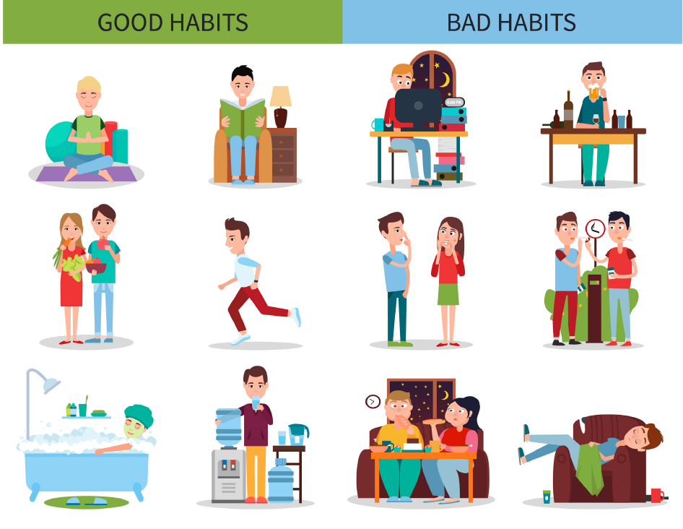
What are these people doing?
Imagine they do this every day.
Who do you think is healthier: people on the right or people on the left?
Why?

Slide 4
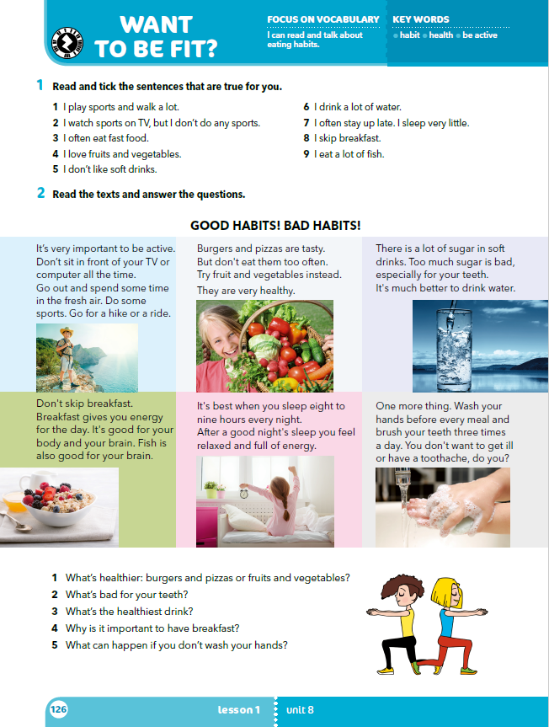
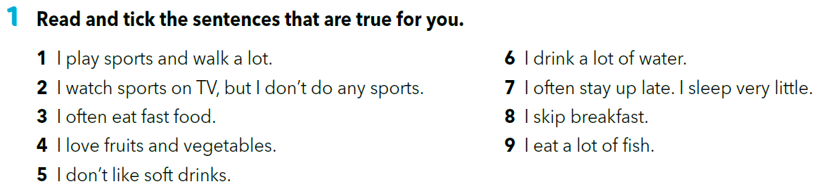
Why is this good for you? Do you know?
Why don’t you …?

Slide 5
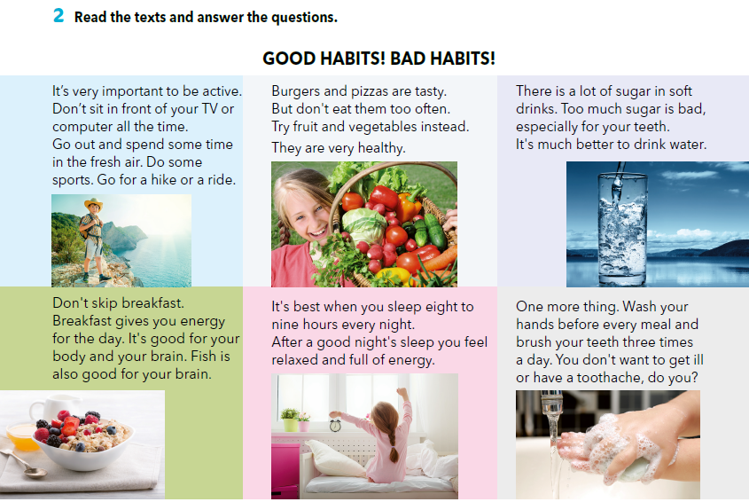
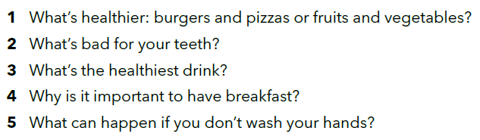
Read the texts and answer the questions in your notebook. Write the answers in full sentences.
Fruit and vegetables.
Too much sugar.
Water.
Breakfast gives you energy for the day.
You can get ill.

Slide 6
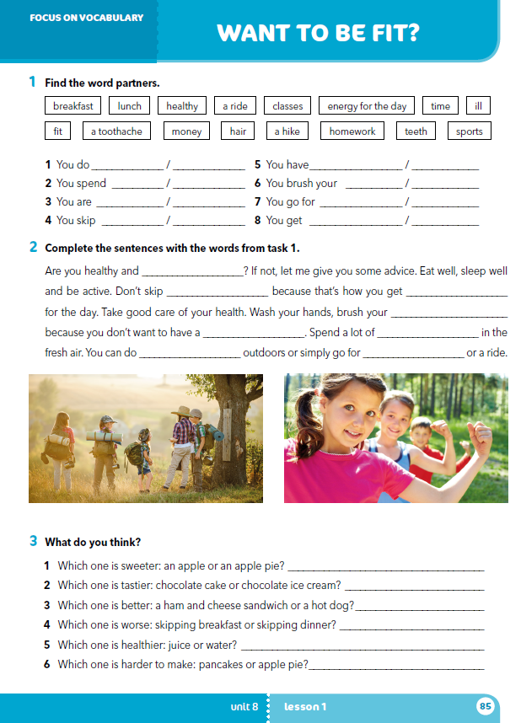
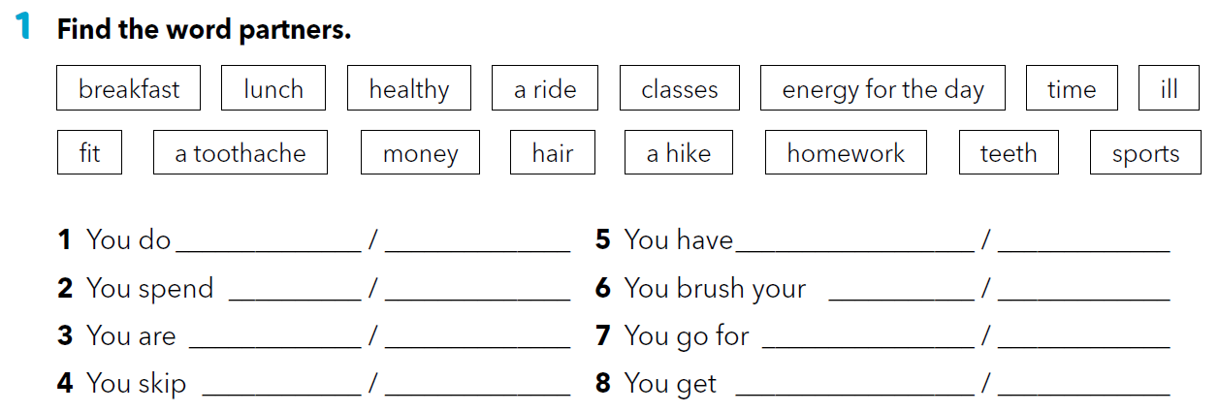
Workbook p. 85
Rad u grupi. Odaberite naputak za zdrav život koji vam se čini najkorisniji i osmislite reklmani poster za njega. Poster treba uključivati ilustraciju ili fotografiju i pamtljiv slogan.
Predstavite svoj rad.
sports
homework
toothache
breakfast
time
money
teeth
hair
healthy
fit
a hike
a ride
breakfast
classes
energy for the day
ill

Slide 7
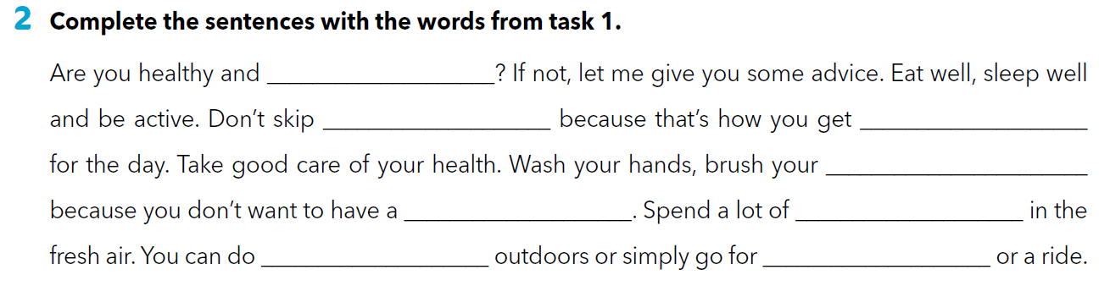
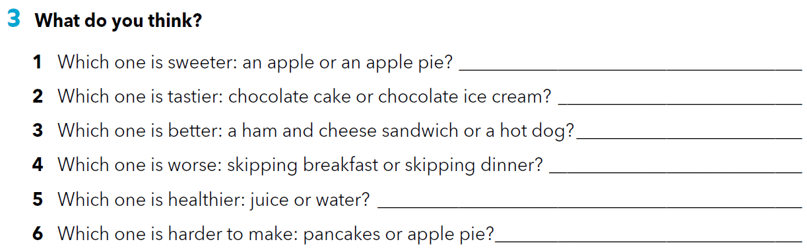
fit
breakfast
energy for the day
teeth
toothache
time
sports
a hike

Slide 8

LET’S REVISE!
https://learningapps.org/watch?v=pcds6agxj18
SELF CHECK
https://www.e-sfera.hr/dodatni-digitalni-sadrzaji/38dd1a77-b398-4f61-b2af-461438412aed/

Slide 9
LEARN MORE.
https://www.e-sfera.hr/dodatni-digitalni-sadrzaji/38dd1a77-b398-4f61-b2af-461438412aed/
Top 5 superfoods

